Slide 1
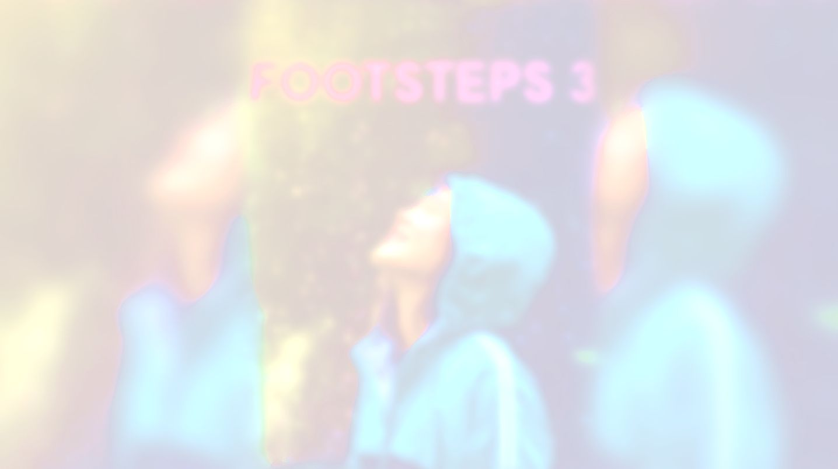
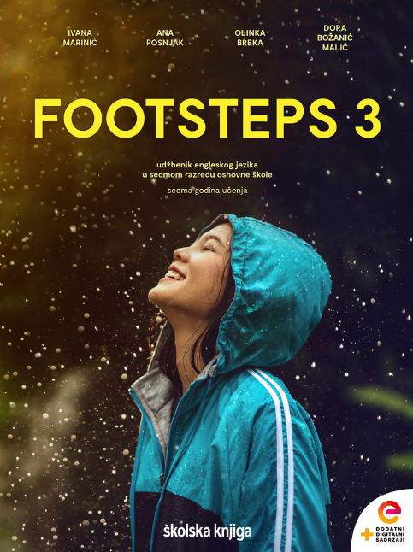

UNIT 5; It takes drive
Bragging

Slide 2
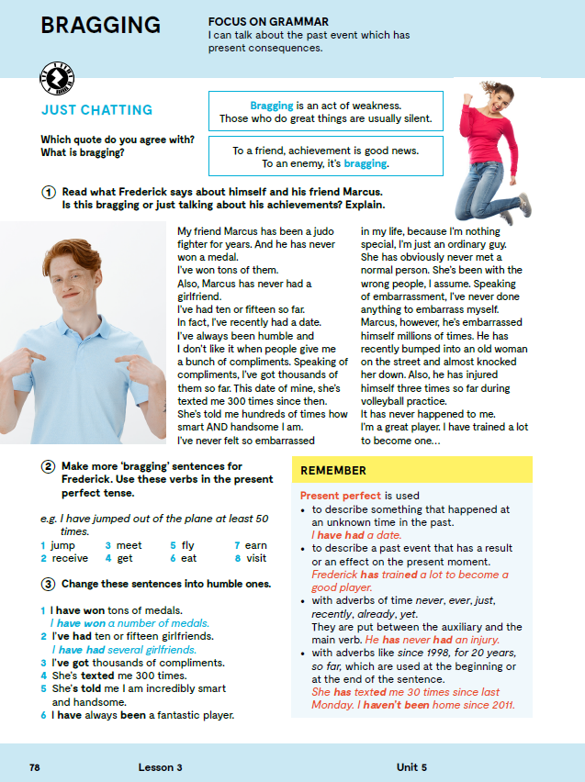
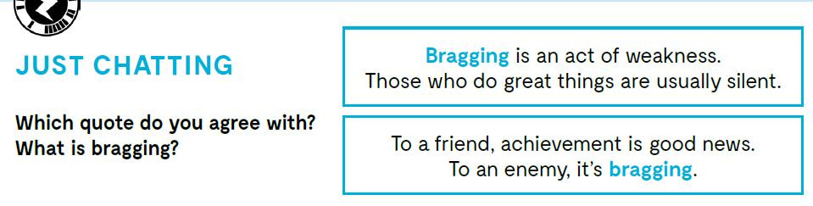

Slide 3

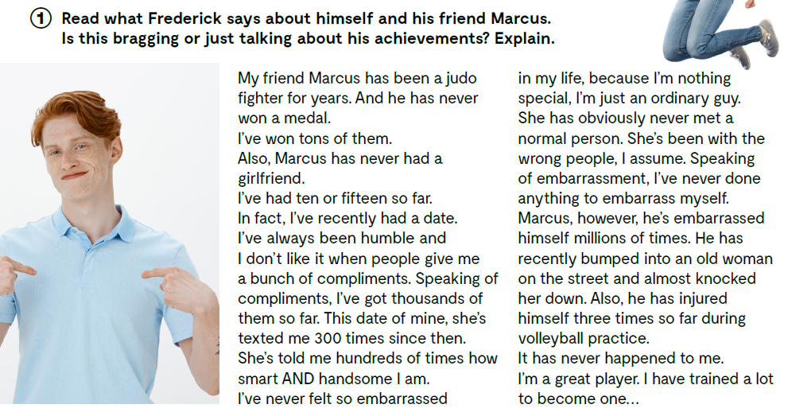

Slide 4
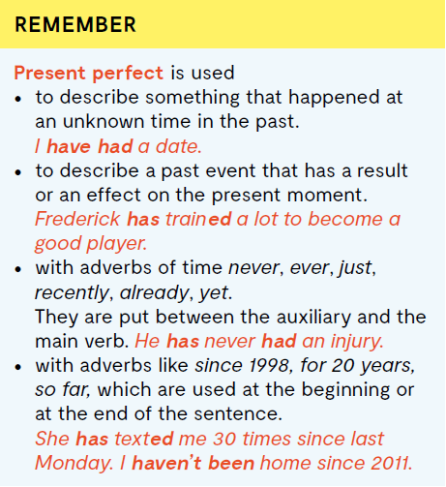
PRESENT PERFECT upotrebljavamo:
kako bismo opisali neku radnju koja se dogodila u neko nepoznato vrijeme u prošlosti! I have had a date.
kako bismo opisali prošli događaj koji ima utjecaja na trenutni trenutak Frederick has trained a lot to become a good player.
sa prilozima: never, ever, just, recently, already, yet; (između pomoćnog i glavnog glagola) He has never had an injury.
uz priloge: for i since; FOR koristimo kako bismo izrazili koliko dugo radnja traje,
SINCE koristimo kako bismo izrazili od kad radnja traje She has texted me 30 times since last Monday. I haven’t been home since 2011.

Slide 5
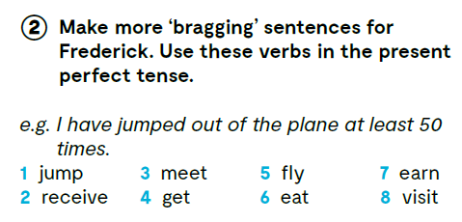
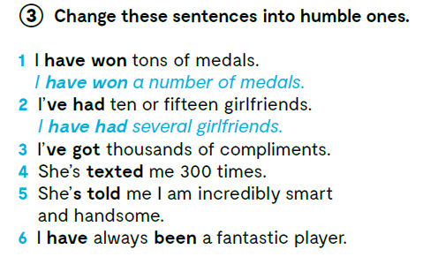
I have received thousands of medals.
3 I have got many compliments.
4 She has texted me many times.
5 She has told me I am intelligent and good looking.
6 I have always been a good player.

Slide 6
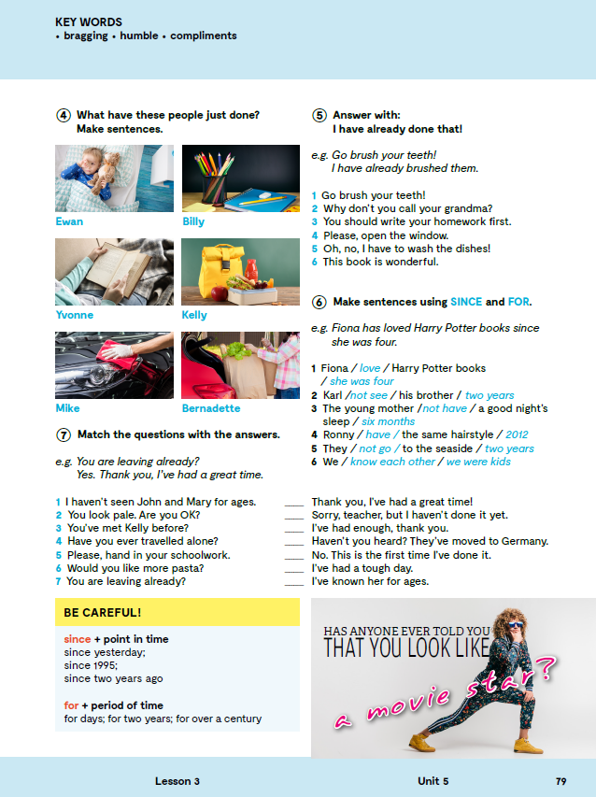
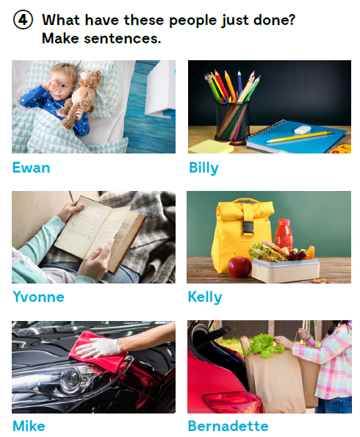
Ewan has just woken up.
Billy has just written his homework.
Yvonne has just read a book.
Kelly has just packed her lunch.
Mike has just washed his car.
Bernadette has just gone shopping.

Slide 7

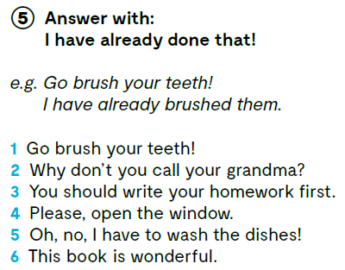
2 I have already called her.
3 I have already written it!
4 I have already opened it.
5 I have already washed them.
6 I have already read it.

Slide 8
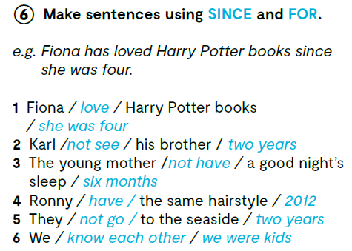
2 Karl hasn’t seen his brother for two years.
3 The young mother hasn’t had a good night sleep for six months.
4 Ronny hasn’t had the same hairstyle since 2021.
5 They haven’t gone to the seaside for two years.
6 We have known each other since we were kids.

Slide 9
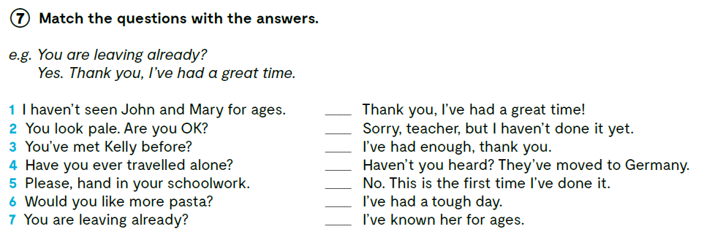
7
5
6
1
4
2
3
Let’s practise: https://wordwall.net/play/847/072/759

Slide 10
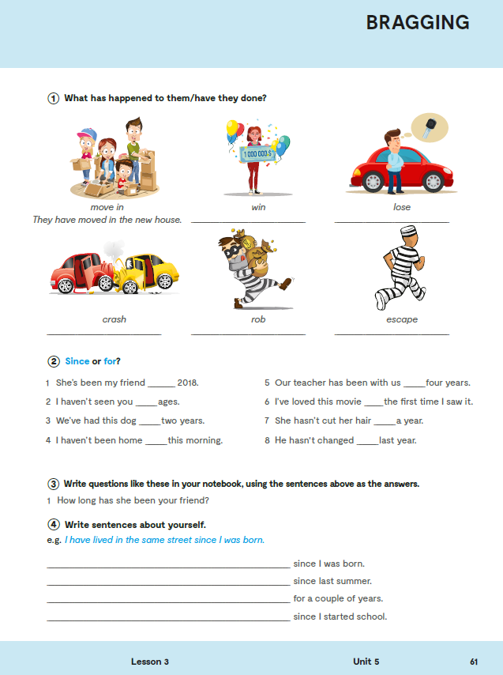
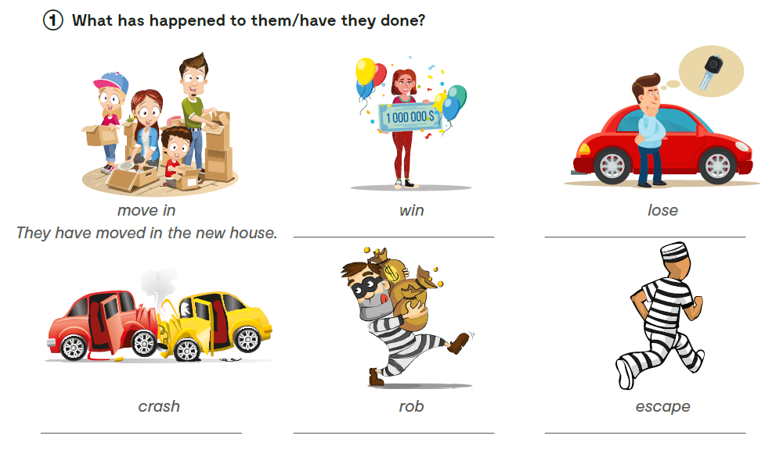
Workbook, p. 61
She has won the lottery.
He has lost his car keys.
They have crashed into each other.
He has robbed a bank.
He has escaped the prison.

Slide 11

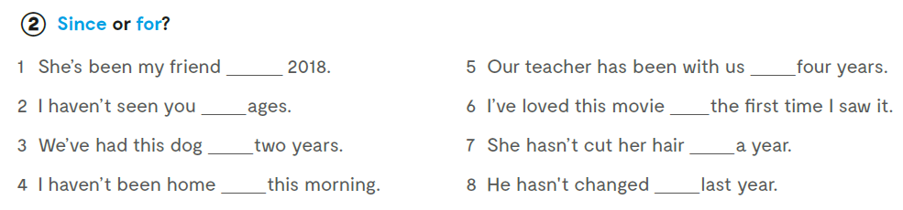
since
for
for
since
for
for
since
since

Slide 12

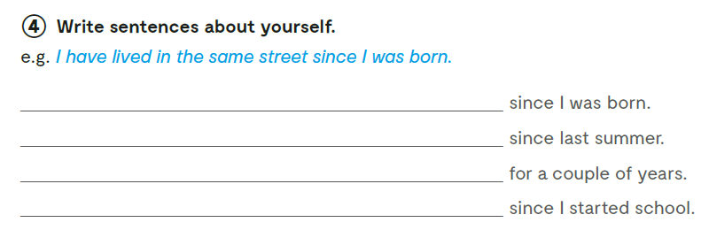

Slide 13
PRESENT PERFECT or PAST SIMPLE?
1 Shakespeare ______________________________(write) some of the best plays in the world.
2 Ransom Riggs ______________________________(write) five novels in the Peculiar Children book series so far.
3 OMG, you ______________________________ (dye) your hair blue. It’s so cool!
4 The first time I ______________________________ (dye) my hair, I was a teen.
5 My dad _____________________ (hitchhike) all over Europe when he was at uni.
6 He _____________________ (not hitchhike) since.
7 Stan Lee _____________________ (create) some of the best Marvel Universe characters.
8 Taika Waititi _____________________ (created) a whole new image for Thor.
9 I _____________________ (see) her today, and it’s almost time for tea.
10 I _____________________ (see) her today, and its almost midnight.

Slide 14

LEARN MORE!
https://www.e-sfera.hr/dodatni-digitalni-sadrzaji/803fcf4e-355b-4b9b-aef0-6e5e412c5ecb/
Teens that have changed the world

